Slide 1
Company presentation
2023

Slide 2
WOOD
PERFECTLY IMPERFECT
Source: ProHolz Austria

Slide 3
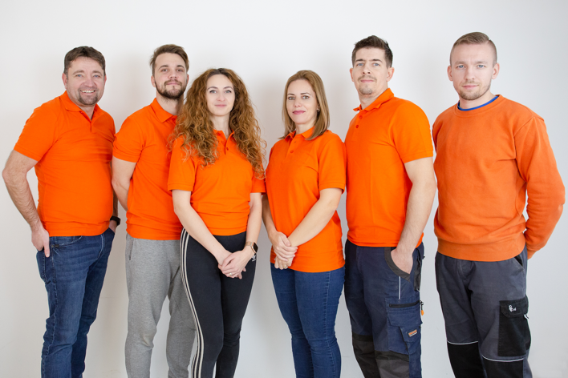
ABOUT US
Manufacture for
Innovative lighting solutions made of solid wood
as individual as your personal fingerprint
Established: 2018
Seat of the company: Opoj /Trnava / Slovakia
Production location: Kuty (3 country triangle AT,CZ,SK)
Start with wood products: 2020
Turnover 2022: 700.000 Euro
Employees: 6
Business background: Lighting

Slide 4
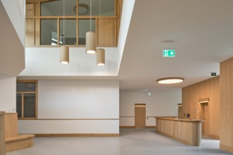
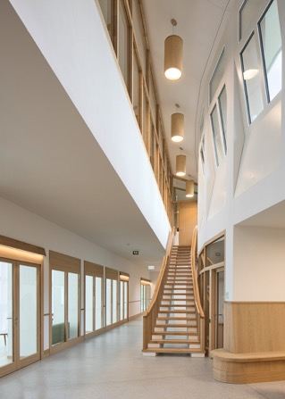
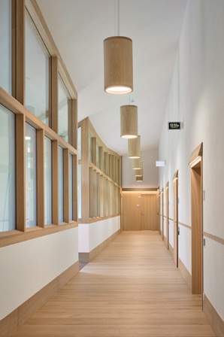
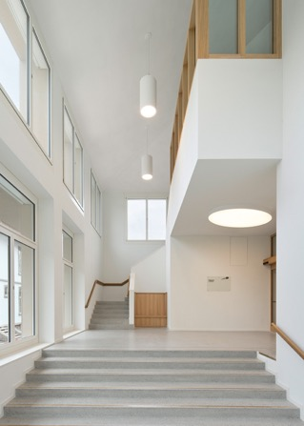
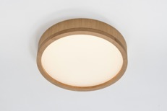
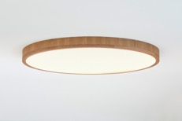
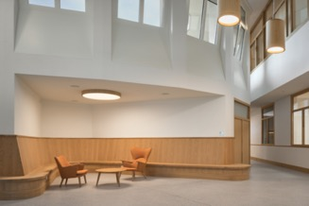
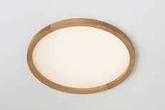
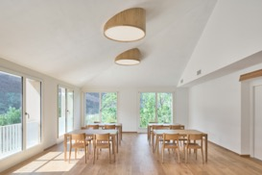
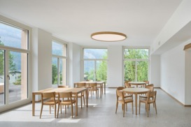
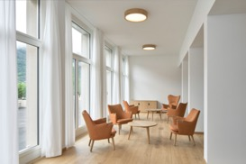
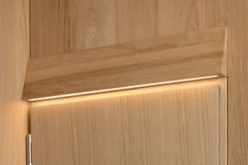
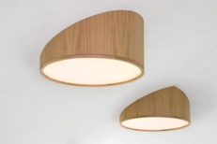
REFERENCE
Biggest solid wood LED project in Europe
Waldhausclinik Chur / Schweiz

Slide 5
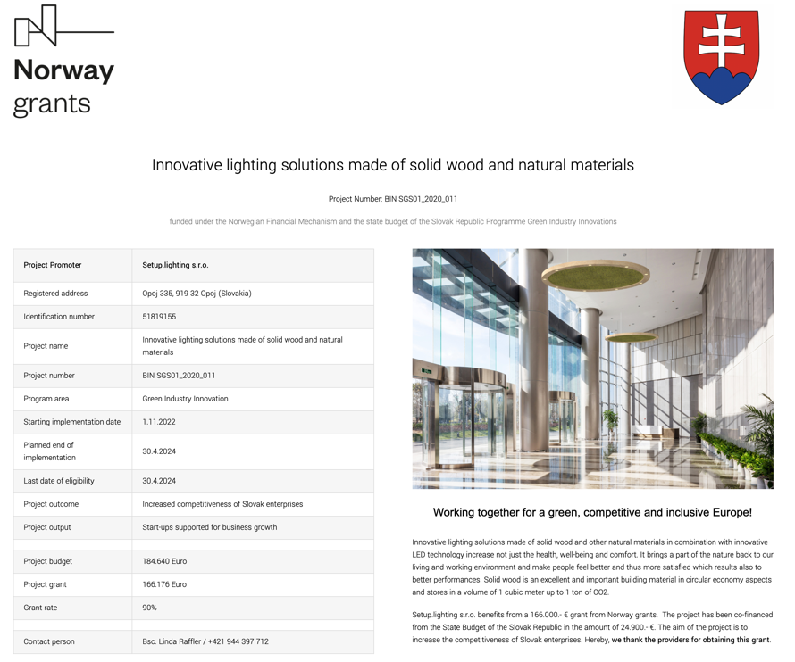
SUCCESSFUL AKQUISITION

Slide 6
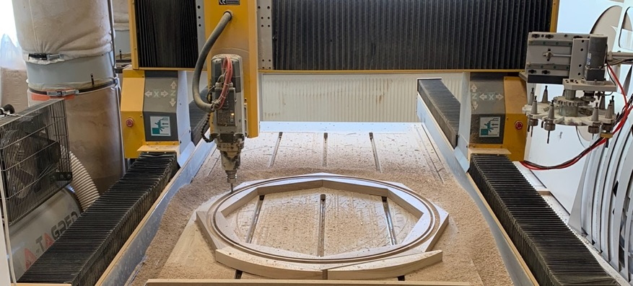
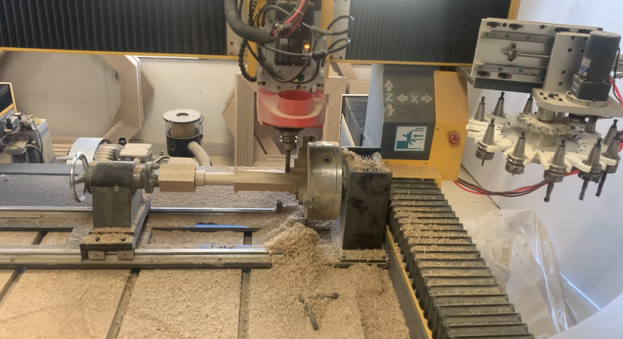
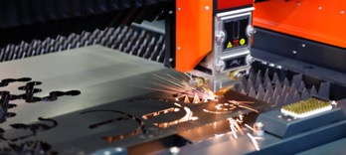
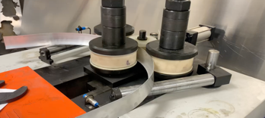
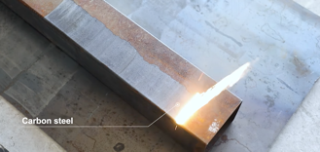
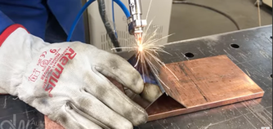
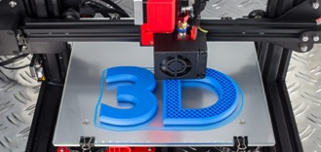
TECHNOLOGIES
CNC Milling (Milling head 90° turnable), CNC turning with rotation axis, Lasercutting, CNC Bending, Laser Welding, Laser Cleaning, 3D Pring

Slide 7
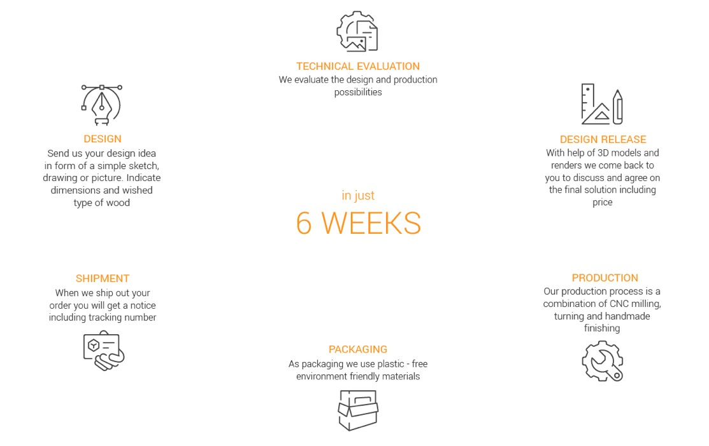
INDIVIDUAL AND FAST

Slide 8
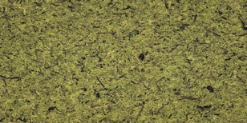
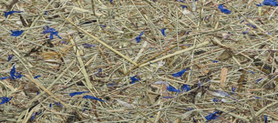
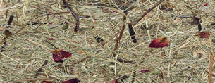
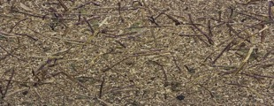
MATERIALS
OAK
METAL
WHITE ASH
COPPER
ORGANOID MATERIALS
AMERICAN WALLNUT
ALUMINIUM
CHERRY
BRASS

Slide 9
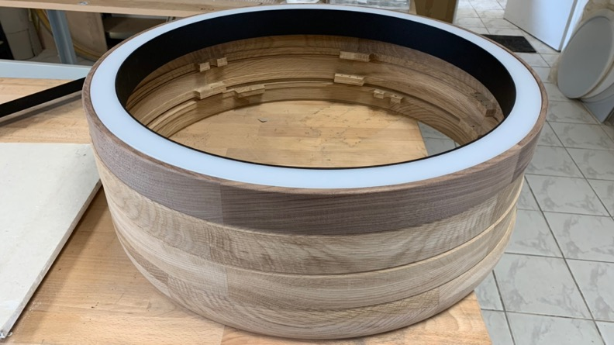
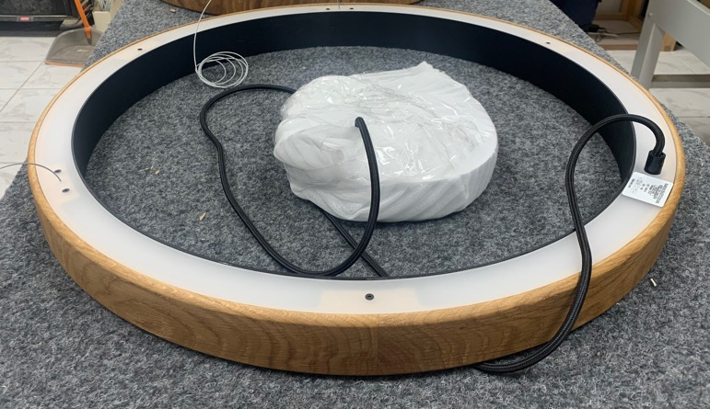
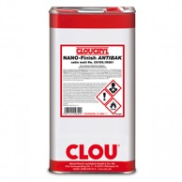
SURFACE FINISHES
NATURAL OR WATERBASED OIL
OILED
WAX / OIL COMBINATION
ANTIBACTERIAL

Slide 10
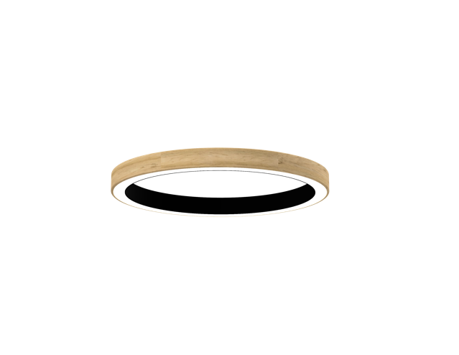
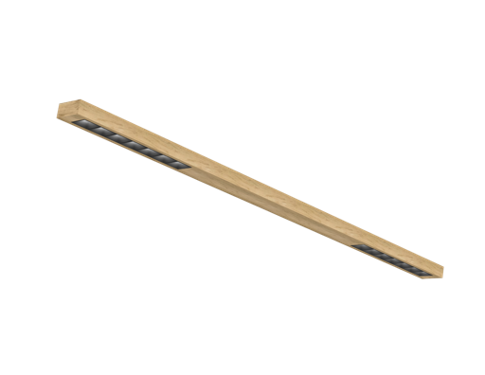
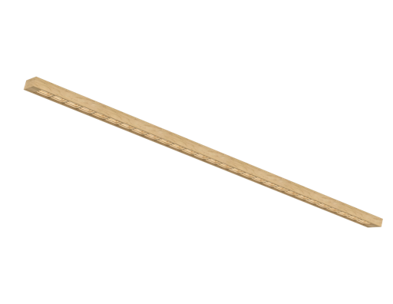
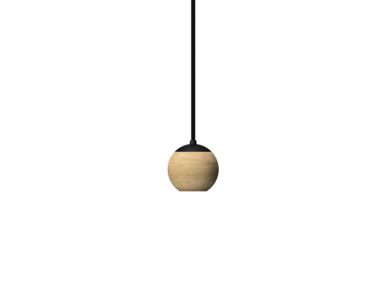
OPTICAL SOLUTIONS
PMMA Diffusor
Microprisma
Precision lens
+
Darklight Reflector
Precision lens
Precision lens
+
Milled light chambers (PURE)

Slide 11
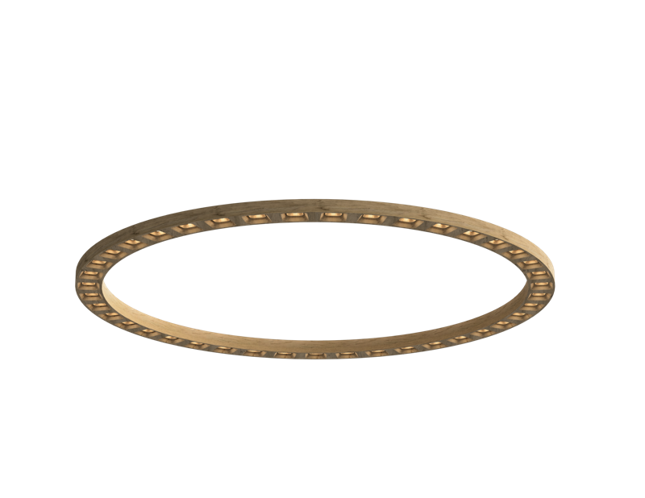
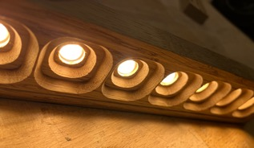
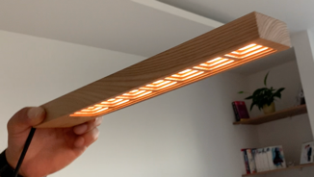
THE “PURE” THINKING
Reduction of plastics on the lowest level combined with unique light effect with milled light chambers
“PURE – pure solid wood”
Milled light chambers with angled surfaces
Milled light chambers with vertical surfaces

Slide 12
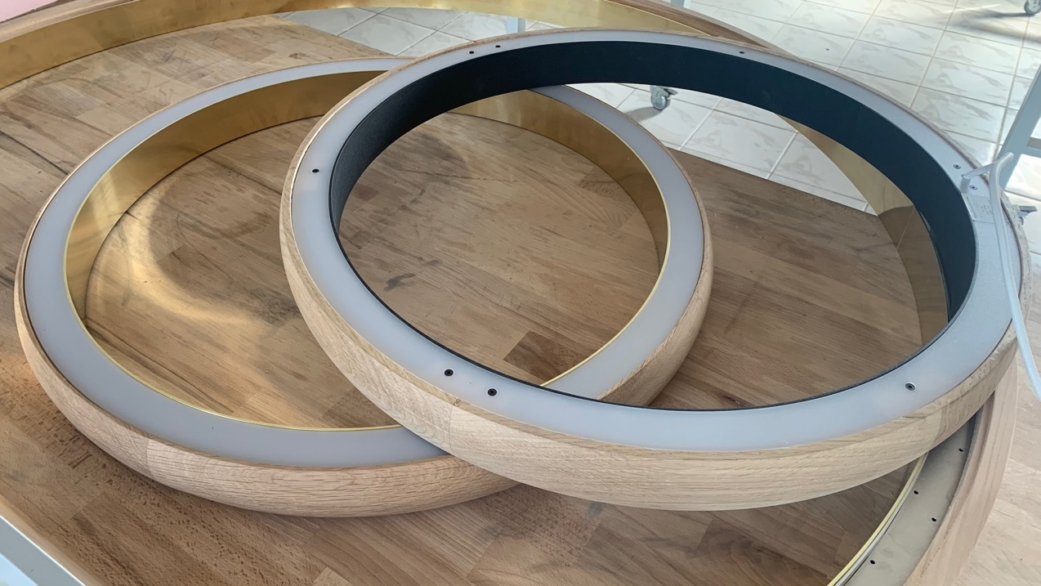
OPPORTUNITIES

Slide 13
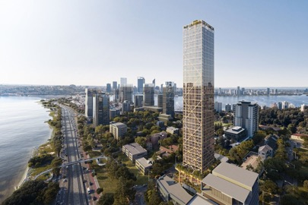
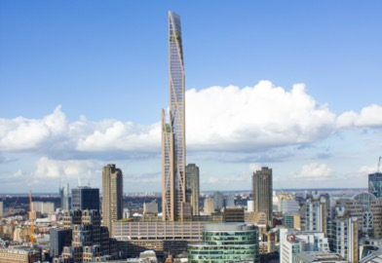
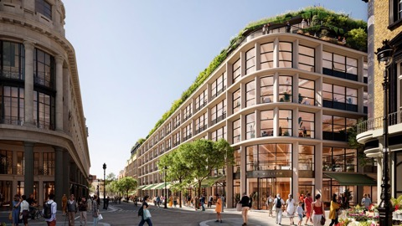
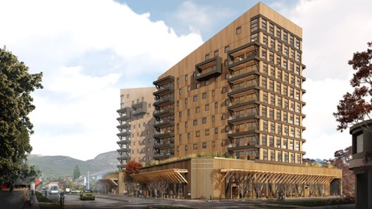
BUILDING WITH WOOD IS TREND
183 m-Turm "C6" AUS / South Perth
Mehrstöckiges Einkaufszentrum UK / London
Bürogebäude in Chile / Patagonia
DAILY NEWS:
SUSTAINABILTIY
CO2 NEUTRAL
CLIMATE FRENDLY
CIRCULAR ECONOMY
HUMAN CENTRIC

Slide 14
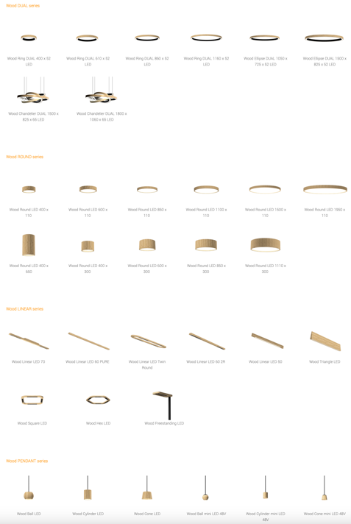
EXTENSIVE PORTFOLIO
FULL DOCUMENTATION
Photometric files
3D Models
Augmented Reality Files
Visualisations

Slide 15
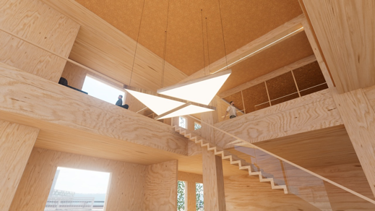
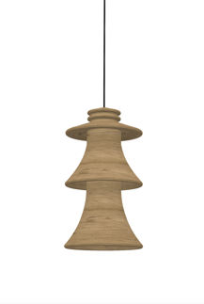
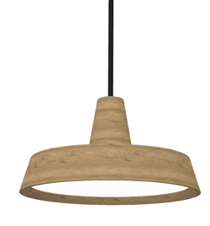
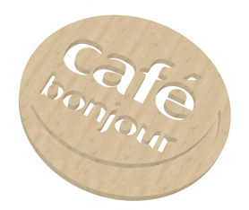
THEMES Make the design fit to the application
Mirror for hairdresser
Luminaire shape as company logo
Isolator for electricity
Sombrero for Mexican
restaurants
Logos

Slide 16
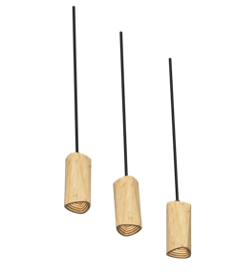
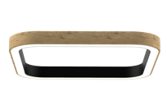
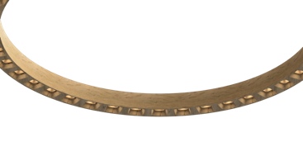
FOKUS IN 2023
Extension Wood MINI
Portfolio
48V / 220V
Extension Wood DUAL
Portfolio
Square shape
Introduction Wood Ring
PURE
Wood Pendant developments
48V / 220V
Strong focus to Design
Products with higher IP rating

Slide 17
THANKS for your attention!
Setup.lighting s.r.o.
SK – 919 32 Opoj 335
https://www.setup.lighting
office@setup.lighting
Mobil: +412 917 684
Pictures and videos
about news out of production
Website

